Slide 1
Financial planning and value for money
Stephen Morales
CEO, ISBL

Slide 2
Financial planning and value for money
What to have in place
What to look out for
Developing a strategic plan

Slide 3
Know your numbers
Staff pay as percentage of total expenditure
Average teacher cost
Pupil-to-teacher ratio (PTR)
Class sizes
Teacher contact ratio

Slide 4
Know your numbers
Proportion of budget spent on the leadership team
3- to 5-year budget projections
Spend per pupil for non-pay expenditure lines compared to similar schools
School improvement plan priorities and the relative cost of options
List of contracts with costs and renewal dates

Slide 5
Applying the 10 checks
Use these 10 checks early in the annual budget planning cycle and when looking ahead at the 3- to 5-year position
Adopt a joined-up approach to leadership. You should be consulting your school business professional as well as your head teacher or CEO
Compare your school’s spending with other schools in similar circumstances via the DfE benchmarking site
You don’t need to be a slave to these numbers, but knowing where you sit nationally might be the start of an important efficiency conversation

Slide 6
1. Staff pay as percentage of total expenditure
Staff pay is the single most expensive item in the school budget. It typically represents over 70% of expenditure.
Questions you might want to ask as part of the governance challenge could include:
What percentage of the budget is spent on staffing compared with similar schools?
How does the percentage for teaching staff, curriculum support staff and other support staff compare with other similar schools?

Slide 7
1. Staff pay as percentage of total expenditure
How do your school’s pupil outcomes – such as your school’s progress score – compare with other similar schools, relative to spend on staffing?
What is the overall staff cost as a percentage of total income? Staffing costs over 80% of total income are considered high.
If teaching costs are relatively high, is this due to the number of teachers or a relatively high proportion of highly-paid staff/leadership?

Slide 8
2. Average teacher cost
This measure is calculated by dividing the total teaching cost by the full-time equivalent (FTE) number of teachers.
You might want to ask:
If the average teacher cost is high in comparison with other similar schools, why is this? Is this due to:
the staffing grade profile, such as a high number of staff on the upper pay scale, or
the responsibilities structure in the school, such as the Teaching and Learning Responsibility (TLR) scale, or
another reason?

Slide 9
3. Pupil-to-teacher ratio (PTR)
The pupil-to-teacher ratio (PTR) is calculated by dividing the number of FTE pupils on roll by the total number of FTE teachers. A relatively low PTR could suggest small class sizes.
As well as benchmarking the PTR, you may want to review the average PTR and pupil to adult (teachers and support staff) ratios in other schools and academies.
The ratio of pupils to all educational staff (including teaching assistants) is also relevant, especially in primary schools.
Research findings suggest teaching assistants are a ‘high cost’ intervention with a mixed impact on pupil education levels, depending upon how they are deployed.

Slide 10
3. Pupil-to-teacher ratio (PTR)
You might want to ask:
What is the PTR for different key stages within their schools?
How does the school’s PTR compare with similar schools? If it’s significantly different, what is the reason for this?
How does the ratio of pupils to staff compare with similar schools?

Slide 11
4. Class sizes
The smaller the class size, the greater the cost of delivery per pupil. Governors should ensure that class size plans are affordable while supporting the best outcomes for pupils.
You might want to ask:
What are the average class sizes by key stage and by options at key stages 4 and 5?
What class sizes does your school aim to achieve – and what is the educational reason for this?

Slide 12
4. Class sizes
Are there any small classes where the per pupil funding does not cover the cost of delivery? This can be especially important at key stage 4 and 5 where class sizes for some subjects can fall.
Do you know the maximum average class size that the school can operate at within the context of the pupil admissions, the structure of the building, the numbers in different year groups and the need for intervention strategies?

Slide 13
5. Teacher contact ratio
This measure is calculated by taking the total number of teaching periods timetabled for all teachers in the school and dividing that by the total possible number of teaching periods (the number of teaching periods in the timetable cycle multiplied by the FTE teachers).
All teachers should have a guaranteed minimum of 10% timetabled planning, preparation and assessment (PPA) time. Therefore, the teacher contact ratio will always be lower than 1.0.

Slide 14
5. Teacher contact ratio
You might want to ask:
How would changes to the teacher contact ratio impact on the overall budget?
Are teaching staff undertaking roles that could be done by support staff?
How does your school compare against ICFP national benchmarks? We’ll come on to this a little later.

Slide 15
6. Proportion of budget spent on the leadership team
Schools have many different leadership and management structures, and comparisons are not straightforward.
Some schools calculate the cost of non-class-based leadership time as a percentage of total expenditure and compare to similar schools by collaborative exchanges of summary information.
Likewise, multi-academy trusts can compare across their member schools where they are similar.

Slide 16
6. Proportion of budget spent on the leadership team
You might want to ask:
How does this compare with similar schools, taking into account any contact time the leadership staff have?
If there is more than one school in your trust or federation, are the leadership structures proportionally the same?
How has your school made decisions on the proportion of its budget to be spent on the leadership team?
If this is relatively high or low compared with similar schools, is this because of the size of the leadership team, or their pay?

Slide 17
7. 3- to 5-year budget projections
You should ask to see 3- to 5-year financial projections and the assumptions made to cost them.
Assumptions you may want to review include:
projected pupil numbers
free school meal numbers
likely pupil premium income
projections of the staffing that will be necessary in these years

Slide 18
7. 3- to 5-year budget projections
Schools should plan their staffing based on multi-year projections of curriculum needs.
You might want to ask:
How confident are you that pupil number projections are realistic? If there is uncertainty, then boards should be given 3 scenarios: cautious, likely, and optimistic.
If the optimistic scenario indicates financial difficulties, is the school developing a recovery plan now?

Slide 19
7. 3- to 5-year budget projections
If the cautious budget indicates potential financial difficulties, what contingency plans does the school have to overcome them?
Are there any issues in the medium term that should be addressed now?
How will current decisions impact medium-term budgets?
What do we need to put in place now to ensure we have the necessary funding in the future?

Slide 20
8. Spend per pupil for non-pay expenditure lines compared to similar schools
You might want to ask:
What is the spend per pupil for catering, ICT, estates management, business administration, energy and curriculum supplies?
If benchmarking indicates a relatively high spend on a particular expenditure line, do you know why?
Are the reasons unavoidable, or are further efficiencies possible?

Slide 21
8. Spend per pupil for non-pay expenditure lines compared to similar schools
If the cost of energy seems high compared with similar schools, can you invest in energy-saving measures to reduce the cost?
If spend on learning resources seems high compared to similar schools, are there opportunities for collaborating with other local schools to bring costs down?
Multi-academy trust (MAT) trustees may also want to compare their level of ‘top slice’ to other MATs, what it is used for, and how it provides value for money for member academies.

Slide 22
9. School improvement plan priorities and the relative cost of options
The budgetary process sits firmly within the strategic leadership framework and should link into the overall management and planning cycle, rather than being seen as an additional activity that is the responsibility of the finance manager. (Later we will talk about joined-up leadership.)
You might want to ask:
Are school improvement initiatives prioritised, costed and linked to the budget?
Are all new initiatives fully costed before your school is committed to the proposal?

Slide 23
10. List of contracts with costs and renewal dates
Each year, your school must review its contracts for all of its services to check which ones are due for renewal. Check that contracts are good value for money (VFM) and meet the school’s needs.
You might want to ask:
Are all contracts due for renewal re-tendered/reviewed for VFM before renewal?

Slide 24
10. List of contracts with costs and renewal dates
Are there any regular payments for services that are an invoice-only contract? Include all goods and services on a contracts list, including single-item and routine purchases, such as stationery. Check all suppliers are on contracts list and review the overall list for VFM.

Slide 25
Bringing it all together through joined-up decision-making and ICFP

Slide 26
The three pillars of education leadership
Pedagogy
Business
Children
Governance

Slide 27
Strategic prioritisation through an integrated approach to curriculum-led planning
Pupil numbers | Year group | Minimum class size | Period 1 | Period 2 | Period 3 | Period 4 | Timetabled periods needed
 | Y7
 | Y8
 | Y9
 | Y10
 | Y11
 |  |  |  |  |  | TOTAL A
Know your contact ratios
Consider space allocation optimisation
Opportunities for aggregation and economies of scale
 | Value | % of overall budget
Leadership
Teaching
Supply & cover
Teaching support
Back office administration
Premises
Professional services
CPD
Classroom resources & equipment
Central services top slice
 | TOTAL C
DfE funding revenue/pupil
Other income
TOTAL B
TOTAL A + TOTAL B + TOTAL C
must = BALANCED BUDGET

Slide 28
What is ICFP?
ICFP stands for Integrated Curriculum Financial Planning
ICFP is an important way to review a school’s financial and resource management planning and use against its widest curriculum delivery aims. It integrates the school and trust’s teaching and learning ambitions and financial resource management into one approach
ICFP uses a reasonably simple set of metrics that assist with collaborative decision-making across the leadership triangle, requiring involvement from school business professionals, senior pedagogical leaders and governors/trustees

Slide 29
What is ICFP?
It is important to mention that ICFP isn’t a new idea and many schools use it to a greater or lesser extent. It isn’t a reaction to a difficult financial situation but should be used as a proactive way of planning and using resources efficiently
There is no prescribed way of implementing ICFP, but there are several well-established approaches in use in the sector
When implemented fully, ICFP can be used to provide the analytical evidence that will inform the medium-term strategic planning as well as the short-term operational management action planning and collaborative decision-making of school business professionals, senior school leaders and governors

Slide 30
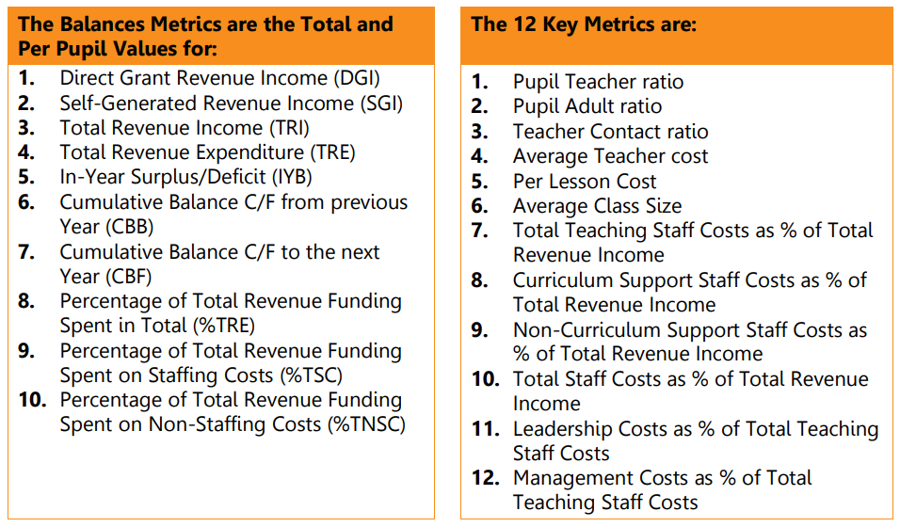
What metrics does ISBL use?

Slide 31
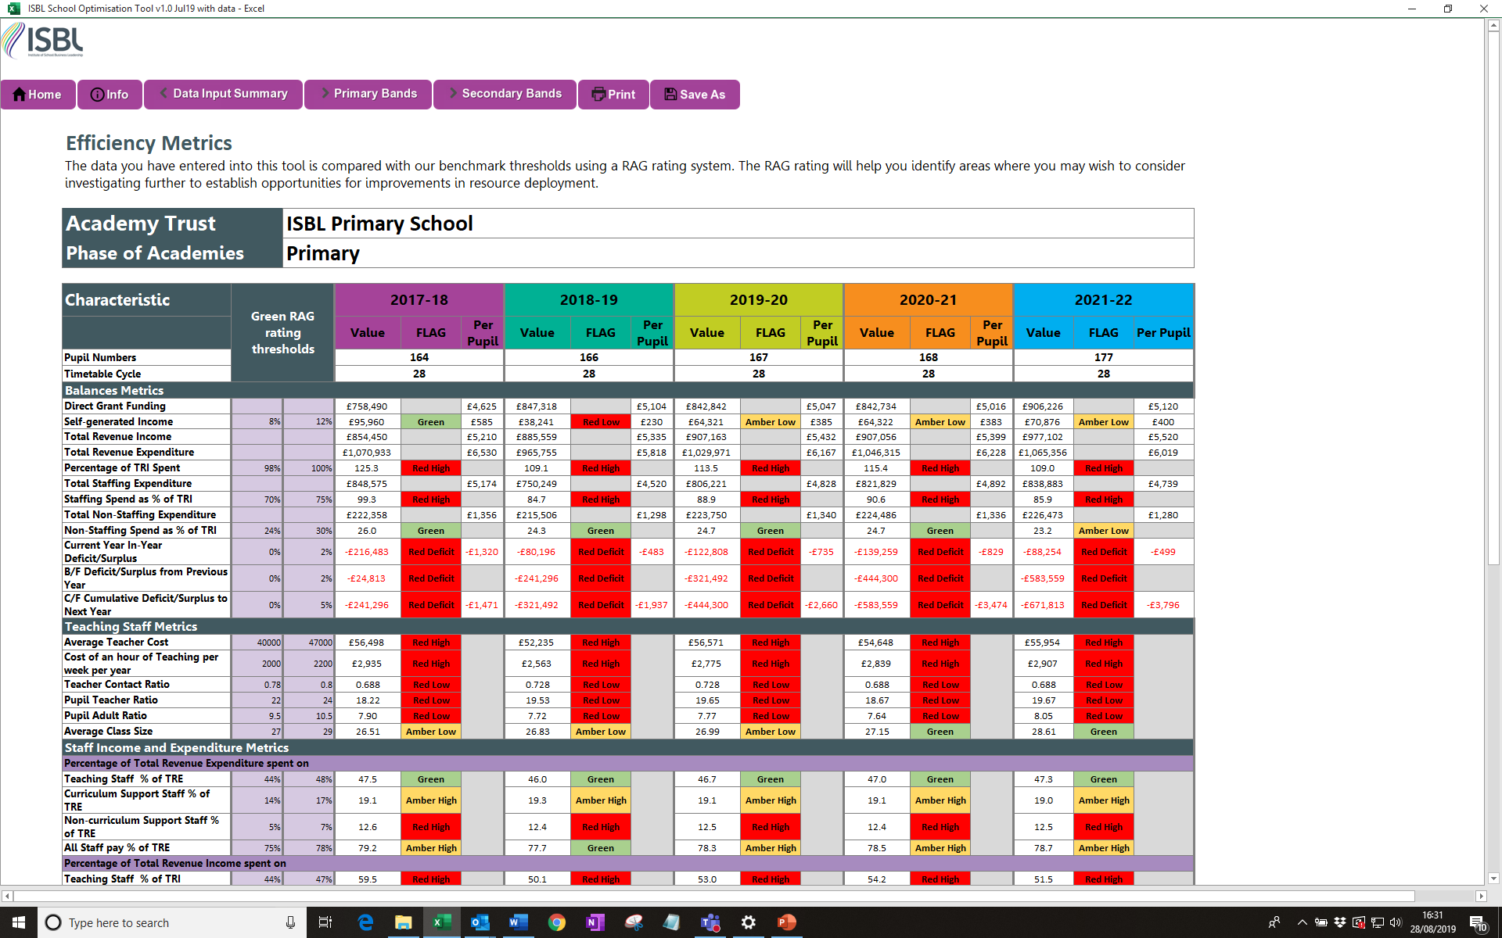

Slide 32
I-SOT: ISBL’s unique tool
Visit https://isbl.org.uk/training/isot.aspx for more information

